Slide 1
Chapter 10 non-Linear optimization models using Excel and ASP

Slide 2
Linear and Non-Linear Optimization Problems
Non-linear optimization problem: Any optimization problem in which at least one term in the objective function or a constraint is nonlinear. These include quadratic equations, trigonometric equations, and others. These models may be constrained or unconstrained.
Examples:
Price of a bond is a nonlinear function of interest rates
Price of a stock option is a nonlinear function of the price of the underlying stock
Marginal cost of production often decreased with the quantity produced
Quantity demanded for a product is usually a nonlinear function of the price.

Slide 3
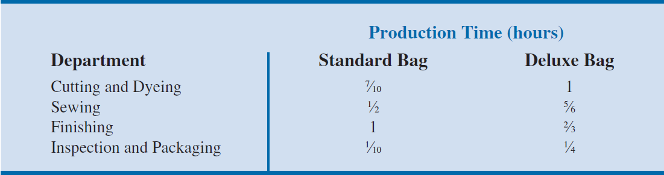
A Production Application: Par, Inc.
Par, Inc. is a small manufacturer of golf equipment and supplies, whose management has decided to move into the market for medium- and high-priced golf bags. Par’s distributor is enthusiastic about the new product line and has agreed to buy all the golf bags Par produces over the next three months. The distributor has agreed to purchase all bags manufactured.
After a thorough investigation of the steps involved in manufacturing a golf bag, management determined that each golf bag produced will require the following operations: cutting and dyeing the material, sewing, finishing (inserting umbrella holder, club separators, etc.), and inspection and packaging.

Slide 4
A Production Application: Par, Inc.
Profit figures are available with $10 profit per standard bag and $9 profit per deluxe bag.
After studying departmental workload projections, the director of manufacturing estimates that the following is needed:
630 hours for cutting and dyeing
600 hours for sewing
708 hours for finishing
And 135 hours for inspection and packaging will be available for the production of golf bags during the next three months
Let’s create a LP model for Par, Inc. first.

Slide 5
A Production Application: Par, Inc.
An Unconstrained Problem
For the Par, Inc. problem we introduce constrained and unconstrained nonlinear optimization problems by considering an extension of the Par, Inc. linear program.
Consider the case in which the relationship between price and quantity sold causes the objective function to be nonlinear. The resulting is an unconstrained nonlinear program.
In formulating the linear programming model for the Par, Inc. problem, we assumed that the company could sell all of the Standard and Deluxe bags it could produce. However, depending on the price of the golf bags, this assumption may not hold.
An inverse relationship usually exists between price and demand. As price increases, the quantity demanded decreases.

Slide 6
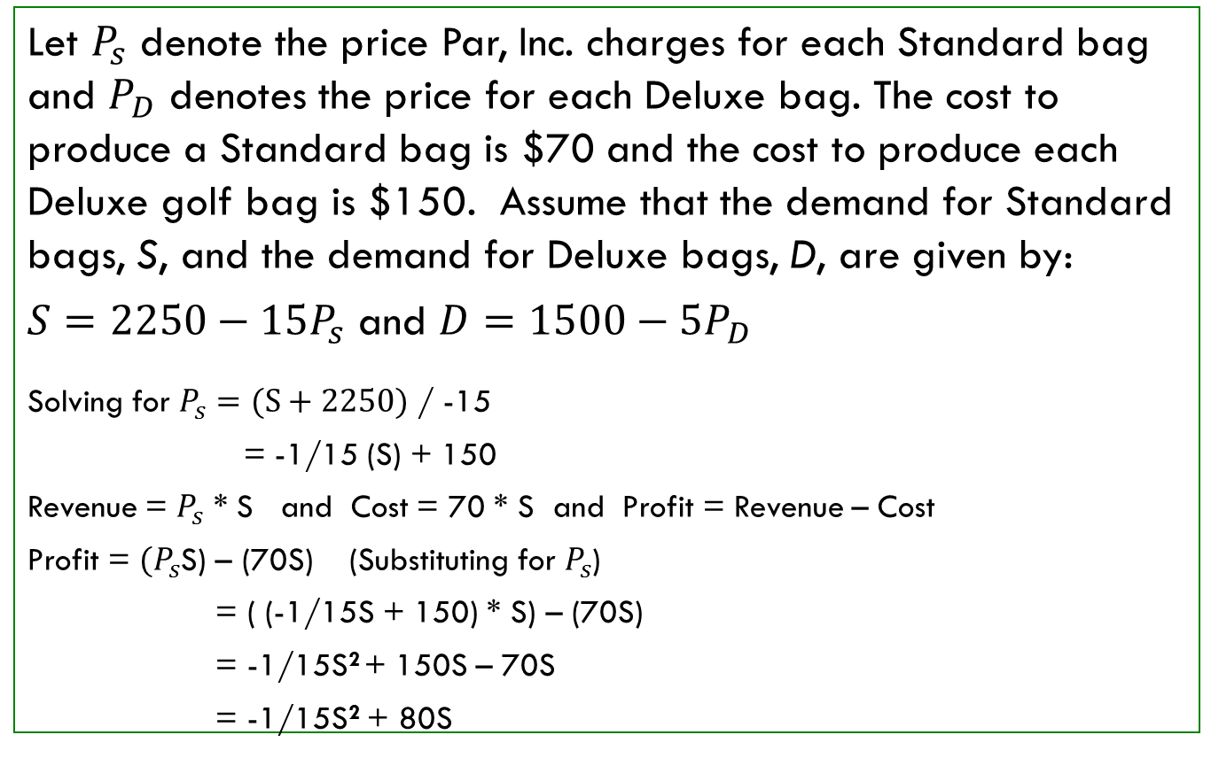
A Production Application: Par, Inc.
Let $P_{s}$ denote the price Par, Inc. charges for each Standard bag and $P_{D}$ denotes the price for each Deluxe bag. The cost to produce a Standard bag is $70 and the cost to produce each Deluxe golf bag is $150. Assume that the demand for Standard bags, S, and the demand for Deluxe bags, D, are given by:
$S=2250−15P_{s}$ and $D=1500−5P_{D}$
Solving for $P_{s}=(S+2250)$ / -15
= -1/15 (S) + 150
Revenue = $P_{s}$ * S and Cost = 70 * S and Profit = Revenue – Cost
Profit = ${(P}_{s}$S) – (70S) (Substituting for $P_{s}$)
= ( (-1/15S + 150) * S) – (70S)
= -1/15S² + 150S – 70S
= -1/15S² + 80S

Slide 7
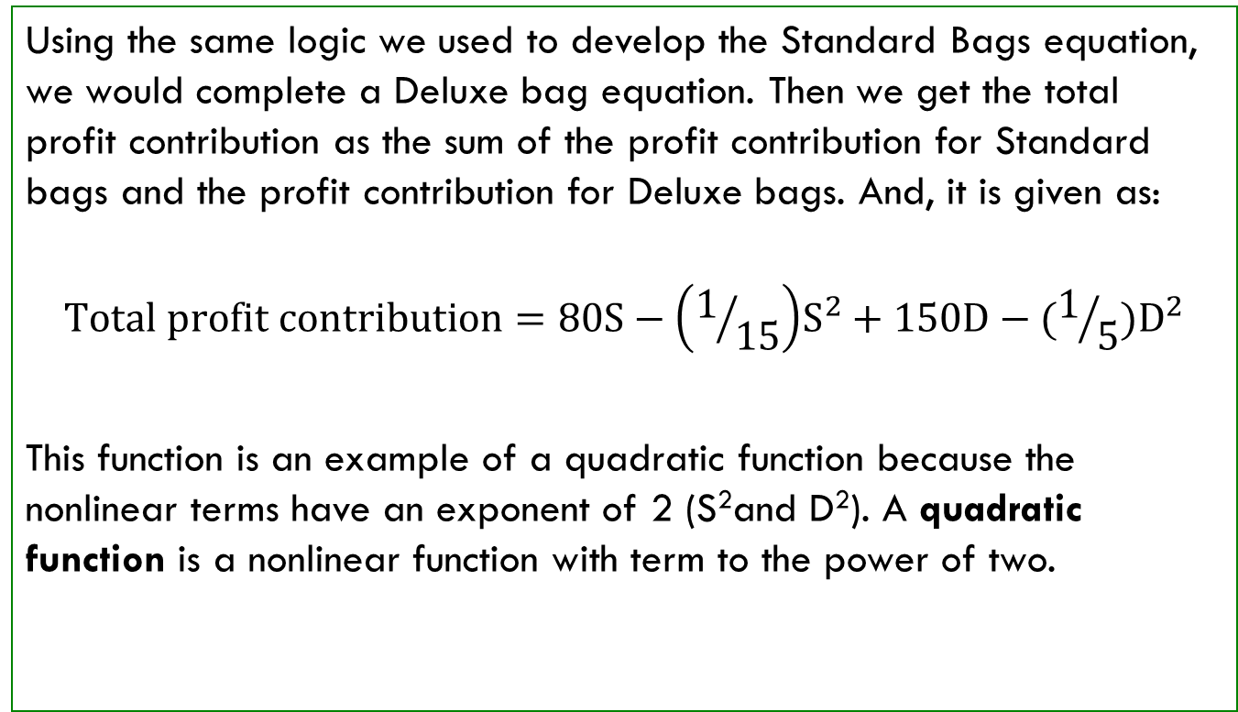
A Production Application: Par, Inc. Revisited
Using the same logic we used to develop the Standard Bags equation, we would complete a Deluxe bag equation. Then we get the total profit contribution as the sum of the profit contribution for Standard bags and the profit contribution for Deluxe bags. And, it is given as:
$$Total profit contribution=80S−\left(1/{15}\right)S^{2}+150D−(1/5)D^{2}$$
This function is an example of a quadratic function because the nonlinear terms have an exponent of 2 (S²and D²). A quadratic function is a nonlinear function with term to the power of two.

Slide 8
A Production Application: Par, Inc. Revisited
Using Excel Solver, we find that the values of S and D that maximize the profit contribution function are S = 600 and D = 375.
The corresponding prices are $110 for Standard bags and $225 for Deluxe bags, and the profit contribution is $52,125.
The feasible region for the unconstrained optimal solution point (600, 375).
The unconstrained optimum of (600, 375) is obviously outside the feasible region because we have not applied the constraints to the problem yet.

Slide 9
A Production Application: Par, Inc. Revisited
A Constrained Problem
In calculating the unconstrained optimal solution, we have ignored the production constraints.
Par, Inc. has limited amounts of time available in each of four departments (cutting and dyeing, sewing, finishing, and inspection and packaging).
The complete mathematical model for the Par, Inc. constrained nonlinear maximization problem follows.

Slide 10
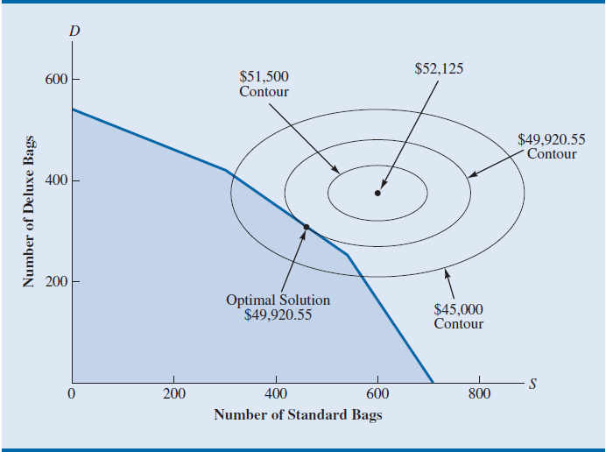
A Production Application: Par, Inc. Revisited
The solution to this new constrained nonlinear maximization problem is shown. Here we see three profit contribution contour lines. Each point on the same contour line is a point of equal profit.
Here, the contour lines show profit contributions of $45,000, $49,920.55, and $51,500, and the profit contours are ellipses.

Slide 11
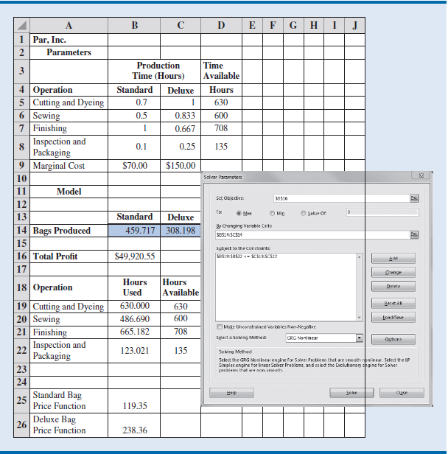
Spreadsheet Model And Solver Dialog Box For The Nonlinear Par, Inc. Problem

Slide 12
A Production Application: Par, Inc. Revisited
The price function for Standard bags is entered in cell B25 as =150-(1/15)*$B$14 and similarly for Deluxe bags in cell C25 as =300-(1/5)*$C$14.
The objective function in cell G17 contains the formula =
(B25-B11)*B14+(C25-C11)*C14, which corresponds to (150 -(1/15)S - 70)S + (300 - (1/5)D - 150)D.
From the Solver dialog box, select GRG Nonlinear from the drop-down menu.

Slide 13
A Production Application: Par, Inc. Revisited
Sensitivity Analysis and Shadow Prices in Nonlinear Models
There are two sections: one for the variables and the other for constraints.
The variables section gives the cell location, name, final (optimal) value, and reduced gradient for each variable.
Reduced gradient is the value associated with a variable in a nonlinear model that is analogous to the reduced cost in a linear model; the shadow price of a binding simple lower or upper bound on the decision variable.
The constraint section gives the cell location, name, and final value for the left hand side of each constraint. The far right column gives the Lagrangian multiplier for each constraint. The optimal value of the objective function is $49,920.55, and this is achieved by producing 460 Standard bags and 308 Deluxe bags.

Slide 14
A Production Application: Par, Inc. Revisited
Lagrangian multiplier is the shadow price for a constraint in a nonlinear problem, that is, the rate of change of the objective function with respect to the right-hand side of a constraint.
For the Par, Inc. example, as we increase the number of hours available in the cutting and dyeing department, we expect the profit to increase by $26.72 per hour.
However, notice that no ranges are given for allowable right-hand side changes. This is because the allowable increase and decrease are essentially zero.

Slide 15
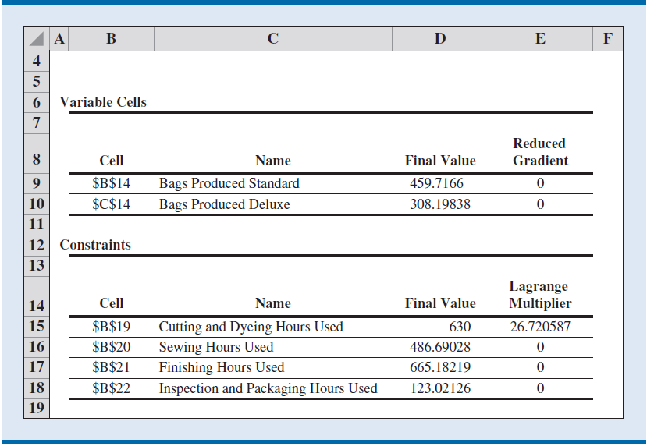
Excel Solver Sensitivity Report For The Nonlinear Par, Inc. Problem
As we increase the number of hours available in the cutting and dyeing department, we expect the profit to increase by $26.72 per hour.
However, notice that no ranges are given for allowable right-hand side changes. This is because the allowable increase and decrease are essentially zero.
Changing the right-hand side of a binding constraint by even a small amount will change the value of Lagrangian multiplier. Nonetheless, the Lagrangian multiplier does give an estimate of the importance of relieving a binding constraint.

